Slide 1
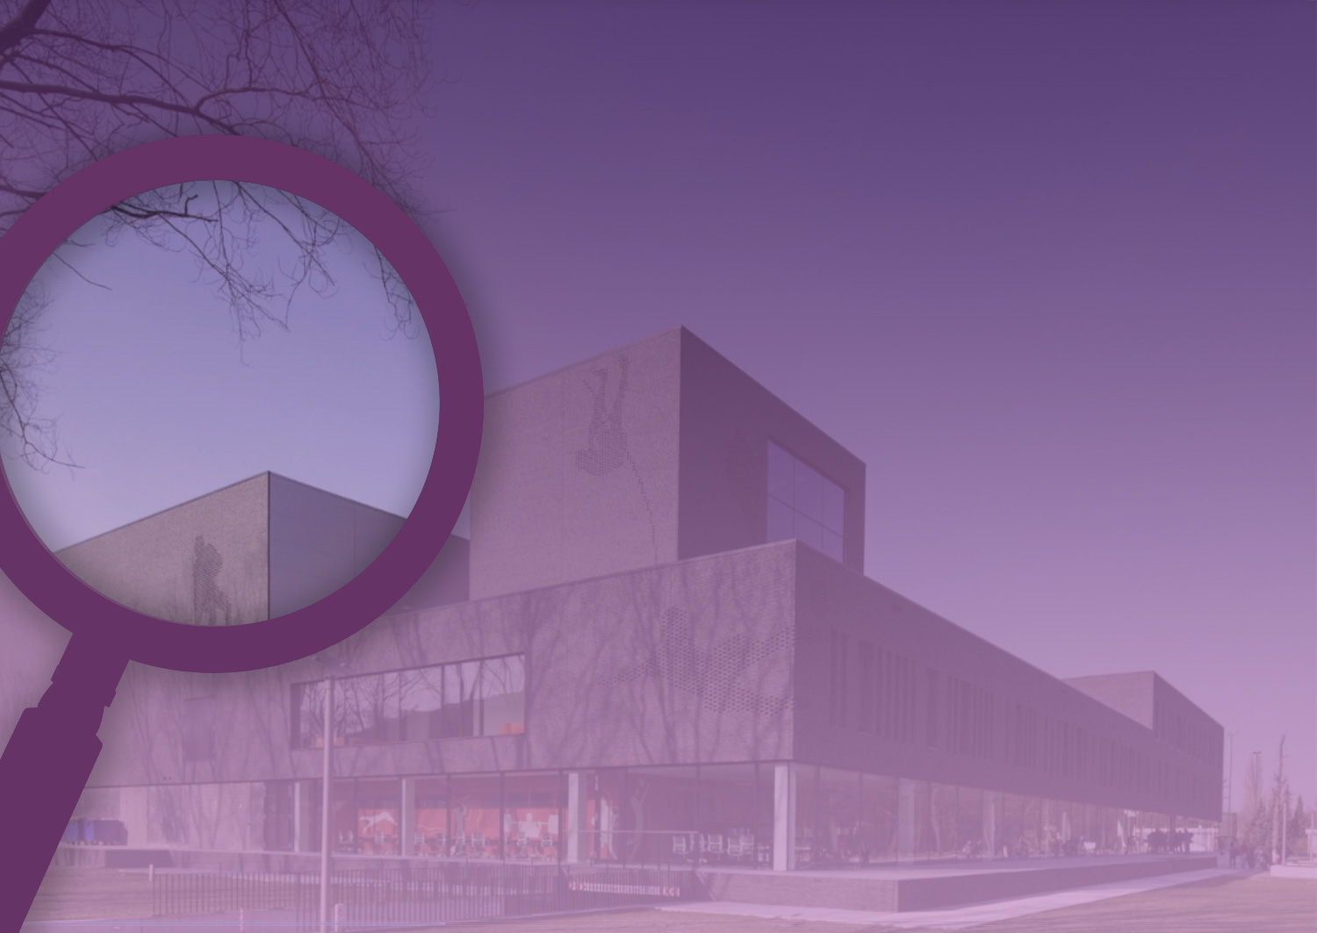
Fontys University of Applied Sciences

Slide 2
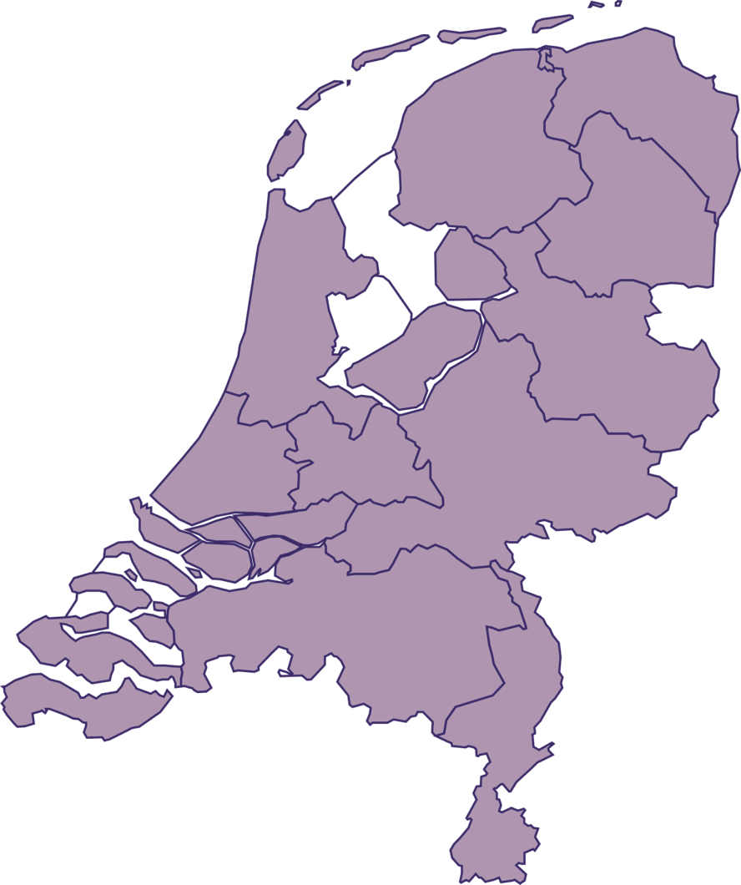
volgende

Slide 3
volgende
Fontys University of Applied Sciences

Slide 4
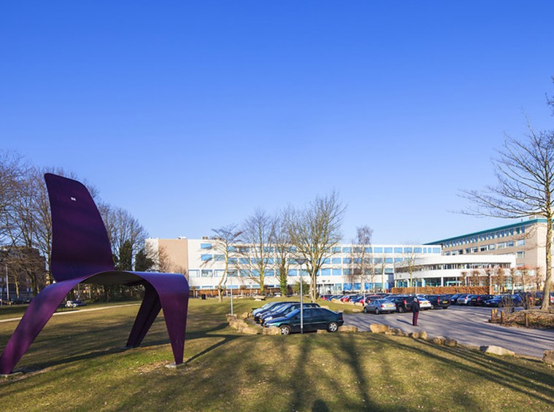
volgende
Knowledge
Development
Innovation
Inspiration
Fontys University of Applied Sciences
A dynamic source of

Slide 5
volgende

Slide 6
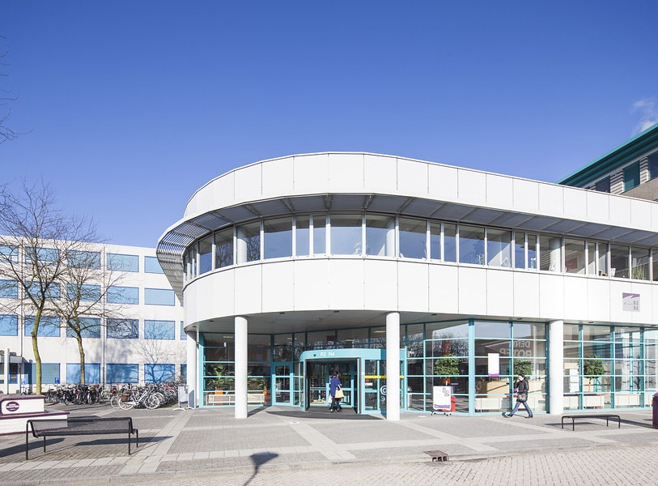
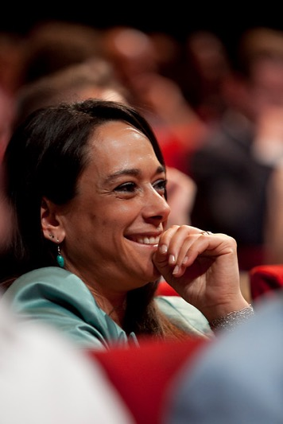
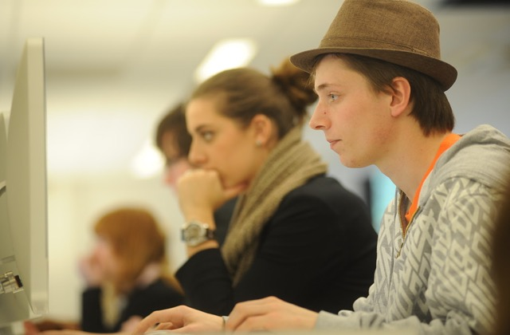
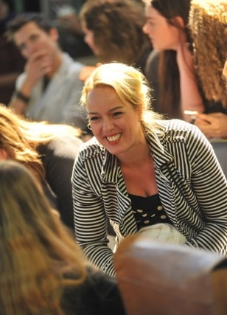
volgende
44.000 students
4.400 members of staff
Course programmes covering
every imaginable field
28 individual institutes
85 BACHELOR PROGRAMMES
40 Masters
11 Associate Degree programmes
Additional courses and trainee programmes
39 LECTORATES

Slide 7
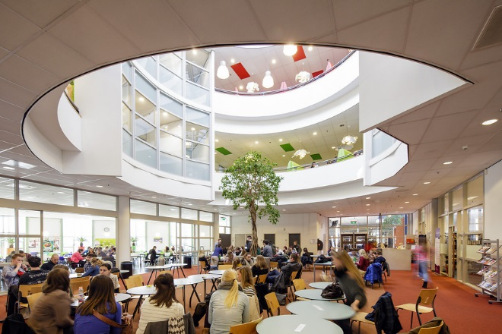
volgende
You want to
THINK
achieve more
THINK
THINK
dIffEreNt
every day
laterally
bigger
bigger

Slide 8
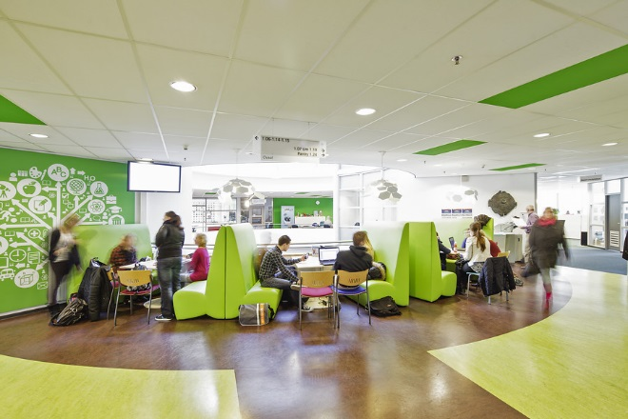
volgende
Explore, pioneer
Exploit the full potential
Extract the maximum

Slide 9
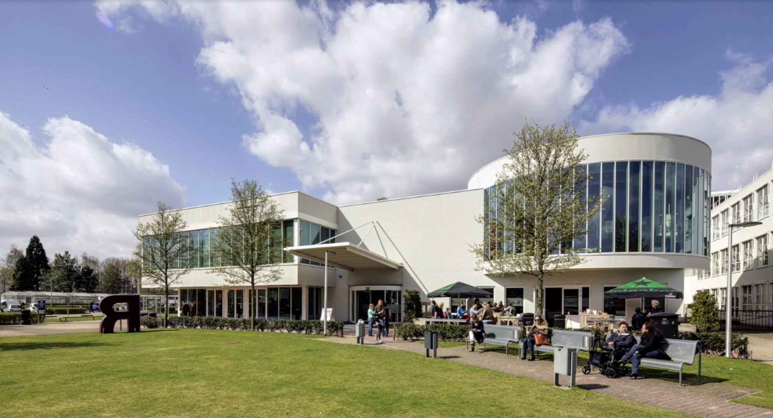
volgende
To students
Get the best out of you
Add value
Take a broader view
And to
partners
on a global
scale
Fontys provides
support and
challenges
To staff
To relevant
stakeholders

Slide 10
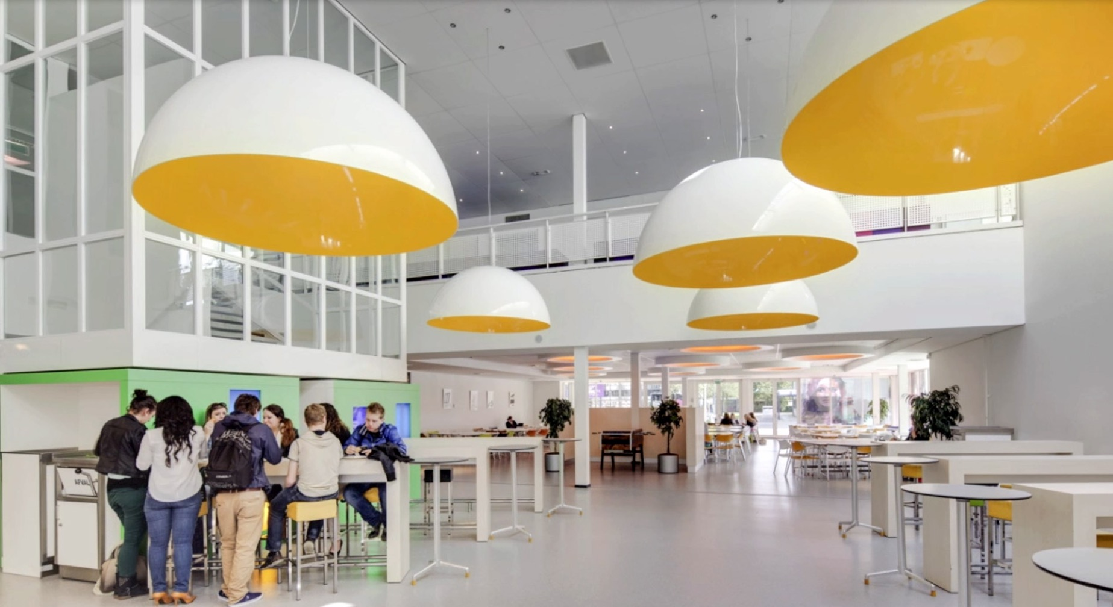
volgende
To students
We give a lot - but expect much in return
Our graduates
● Are highly qualified
And to
partners
on a global
scale
To staff
● Are inspiring
● Can develop and share knowledge
● Have a relevant network
To relevant
stakeholders

Slide 11
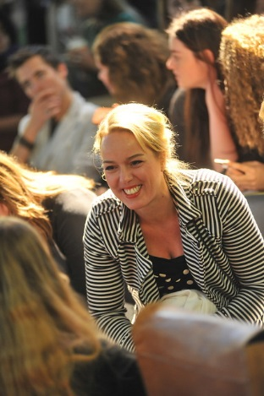
volgende
We
focus on quality
We
contribute to the
development and
nurturing of talent
To
a development and
awareness of values
Preparing students for professional practice… and for life.

Slide 12
volgende
Fontys is innovative and
practice-based
Applied research
distinguishes us from
educational institutes doing
scientific research

Slide 13
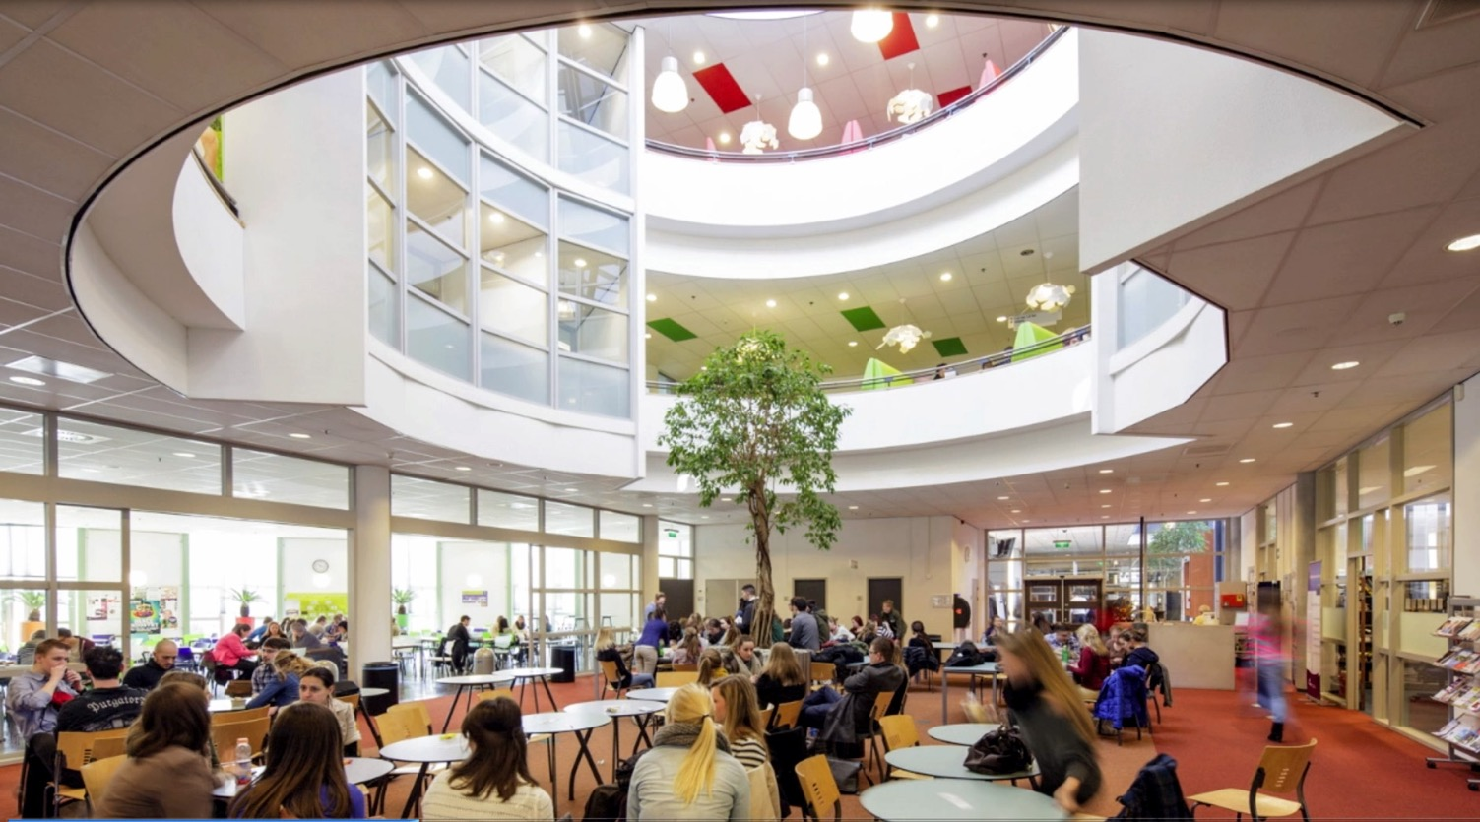
volgende
Thanks to collaboration and consultation
We minimise the gap between education and professional life
And stay in the forefront of academic developments

Slide 14
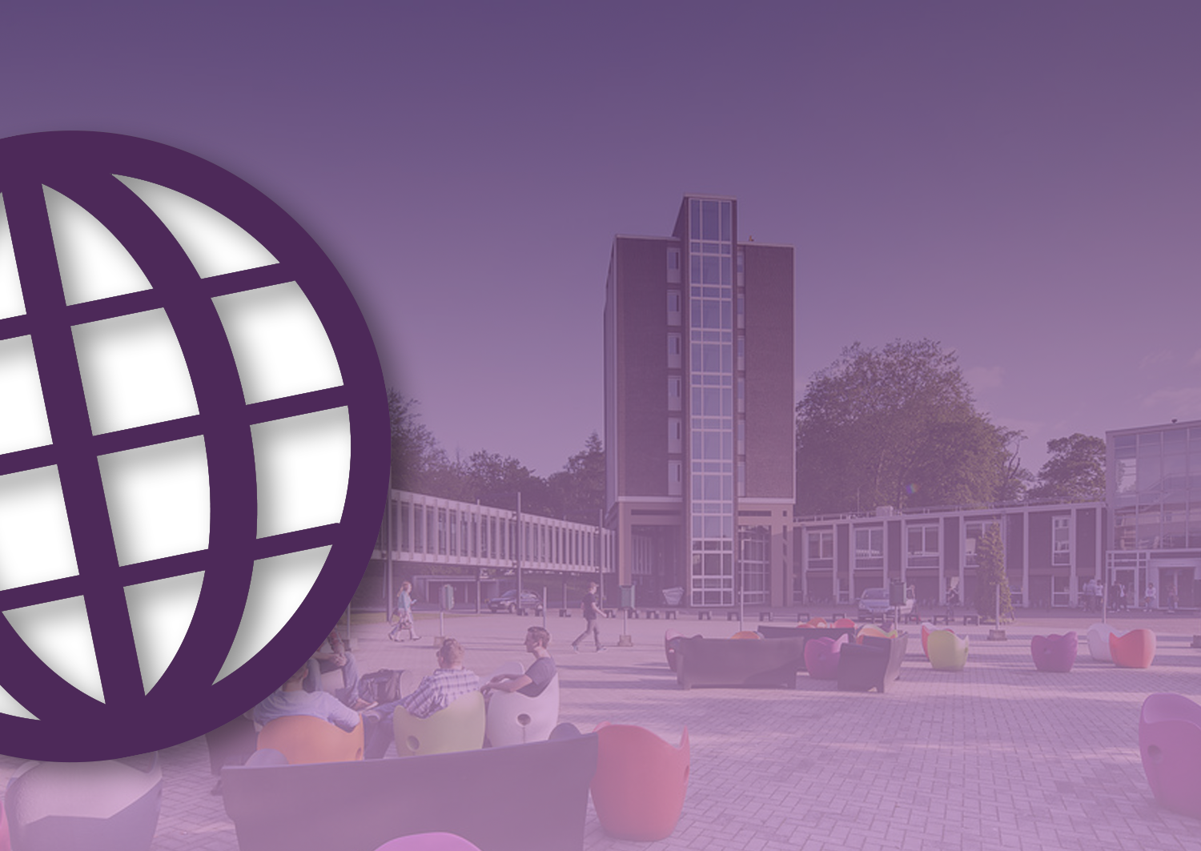
volgende
Well-known in all parts of the world
in a range of fields
Fontys is a powerful innovative
player in a European and
global context
governments
industries
educational institutions
and civil society
organizations
A strong supporter of
interdisciplinary collaboration

Slide 15
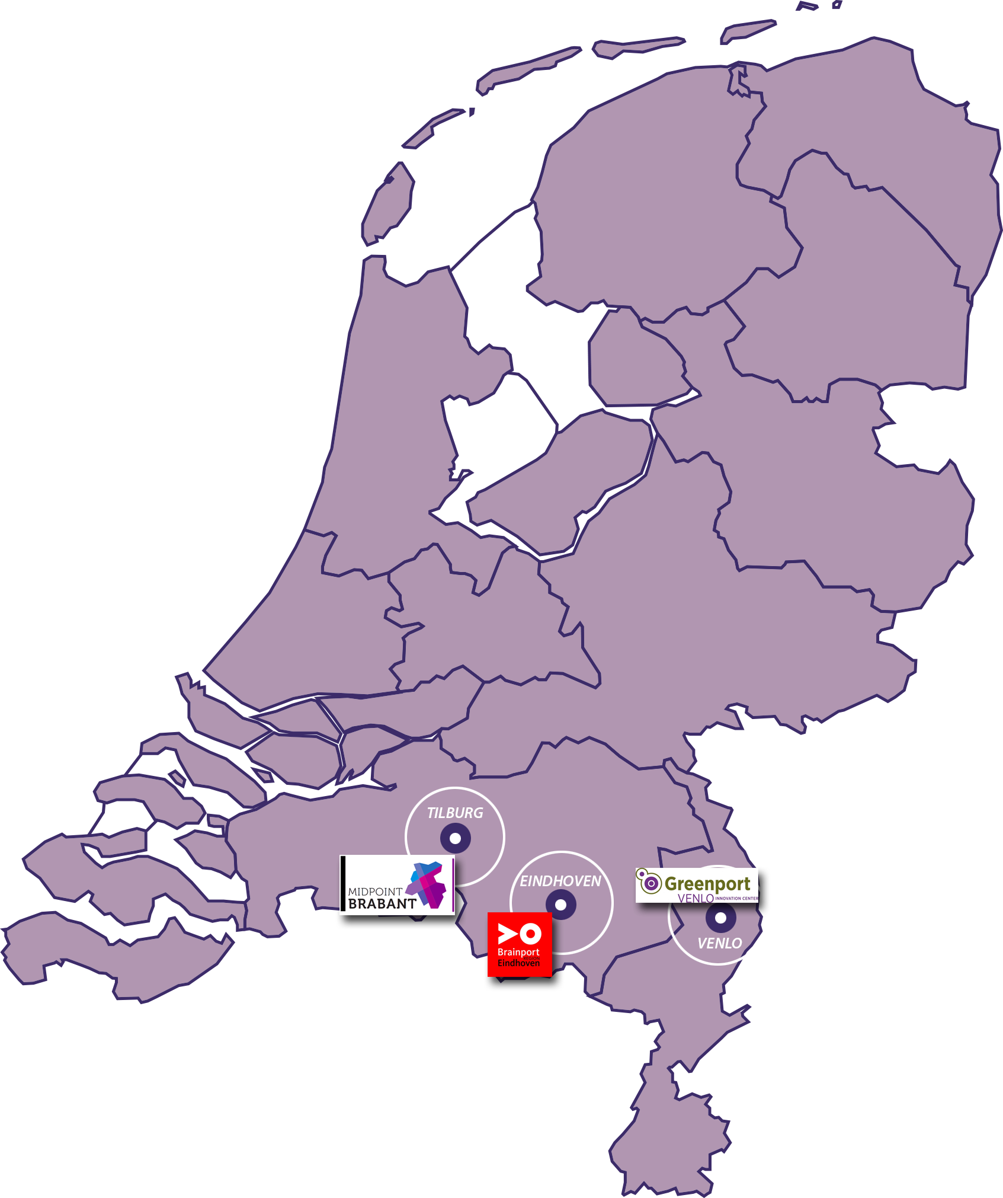
volgende
Right in the centre of
● Brainport, our industrial heart
● Midpoint, center of social
innovation
● Greenport, top region for
entrepreneurs

Slide 16
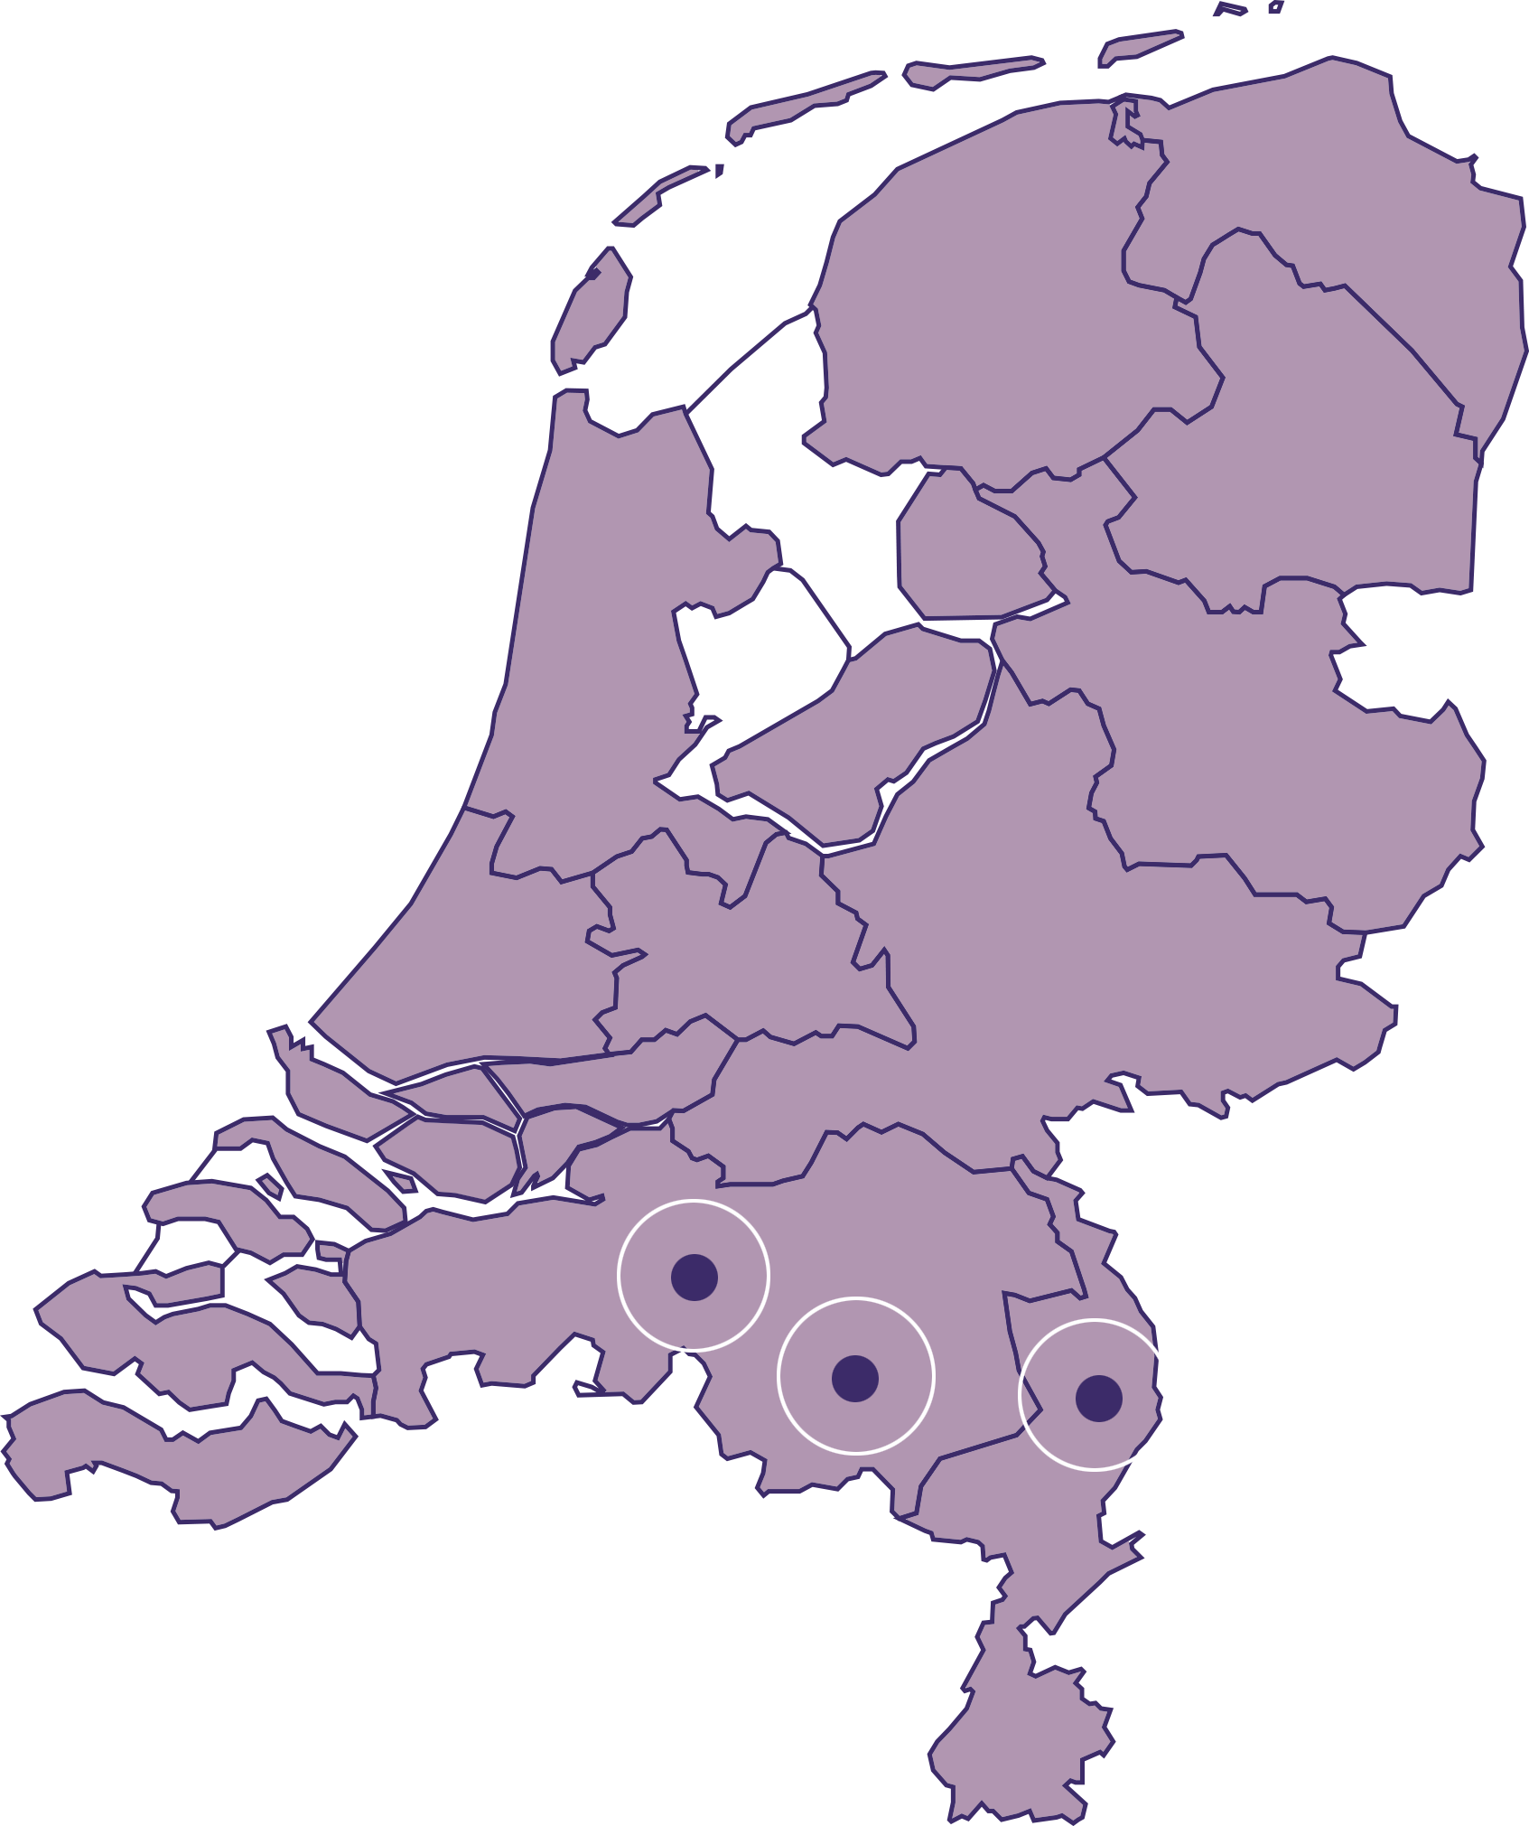
volgende
In these regions, high-tech technology and design are the basis
Learning and working in a top technology breeding ground for innovation
Home to world-class businesses and knowledge and research institutes

Slide 17
volgende
Home to world-class businesses and knowledge and research institutes
Internationalisation contributes
to the quality of our research
and education
It enriches our curriculum
It prepares students for the international professional practice
It inspires and internationalises our teachers and staff

Slide 18
volgende
Fontys has agreements with universities from around
the world
Latvia
Canada
Ireland
Argentina
Switserland
Embedded in the region
Excelling outside the school walls
Contribute to the economy and society
Portugal
Uruguay
Nepal
Australia
Denmark
Turkey
Finland
Macedonia
Korea
Germany
Slovakia
Taiwan
Barbados
Russia
United Kingdom
USA
Austria
Thailand
Bulgaria
South Africa
Romania
France
Malaysia
Sweden
China
Mexico
Iceland
Italy
Norway
Spain
Estonia
Zambia
Brazil
Belgium
Hungary
Indonesia
Marocco
India
Japan
Lihuania
Cyprus
Poland
Chech Republic

Slide 19
volgende
Growth through focus and challenge

Slide 20
Fontys University of Applied Sciences

